Slide 1

Snake Game
Nikhil V., Timon S., Hanlin S., Anurag K.
Java Final Project
Introduction to Java, CIS 043

Slide 2



How it Works
Graphics
Keyboard Inputs
Complex Language
Sleek GUI with numerous features, including snake, food, and board
Uses simple, specific commands and performs corresponding actions
Program encompasses both learned and new java syntax

Slide 3
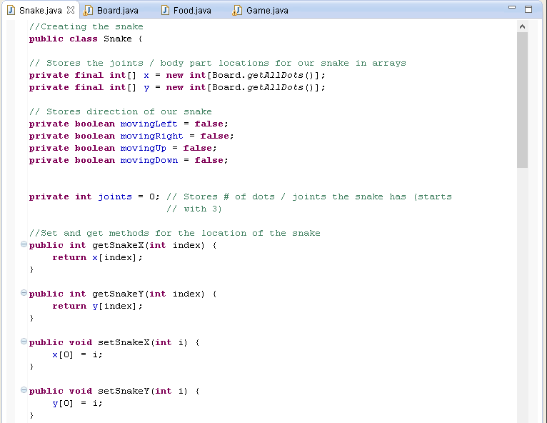
Snake.Java

Slide 4
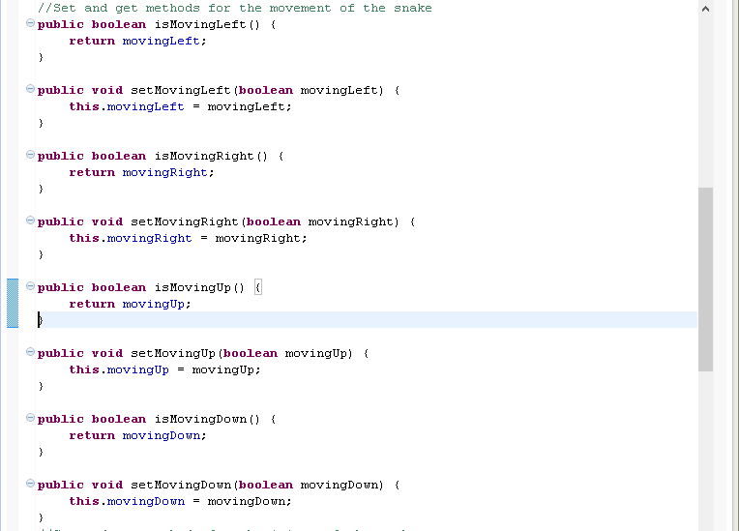
Snake.Java

Slide 5
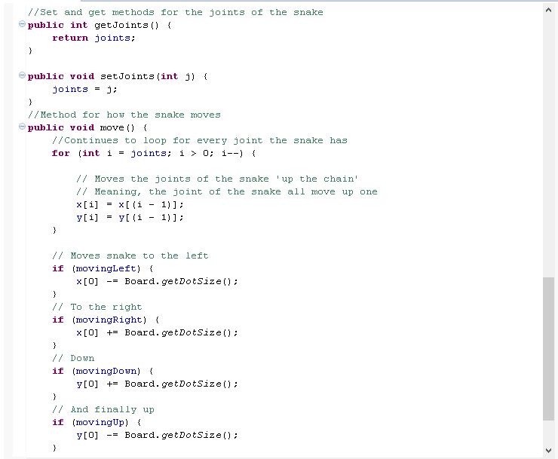
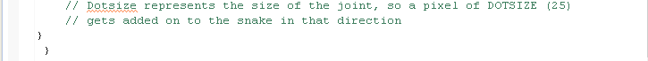
Snake.Java

Slide 6
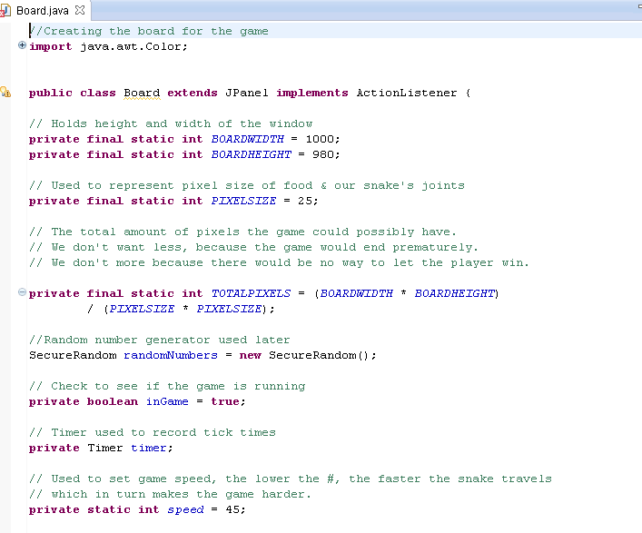
Board.java

Slide 7
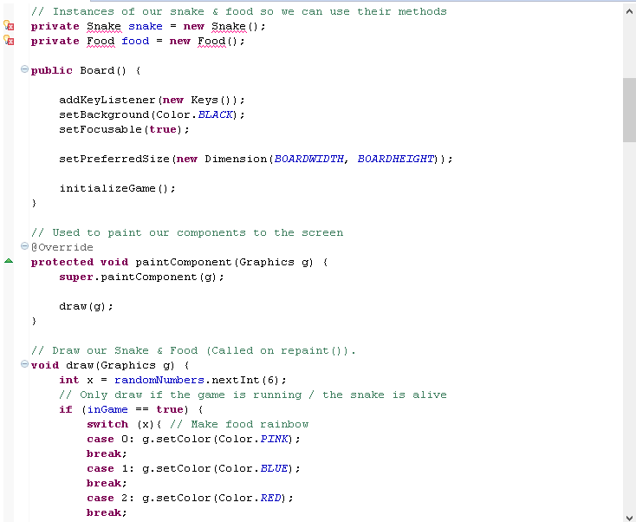
Board.java

Slide 8
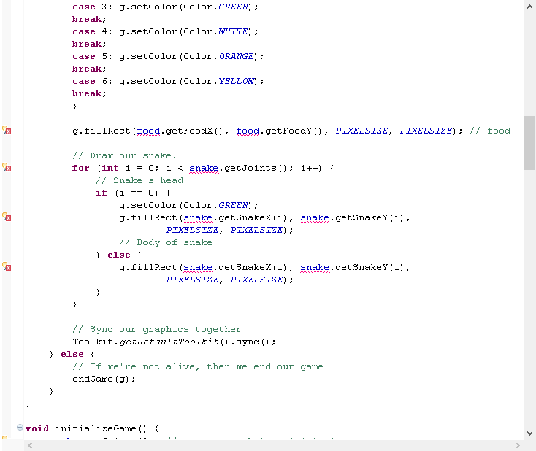
Board.java

Slide 9
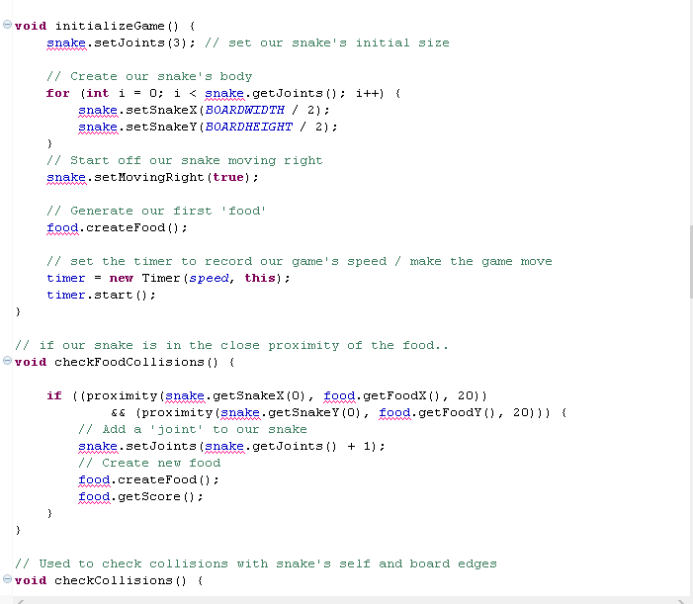
Board.java

Slide 10
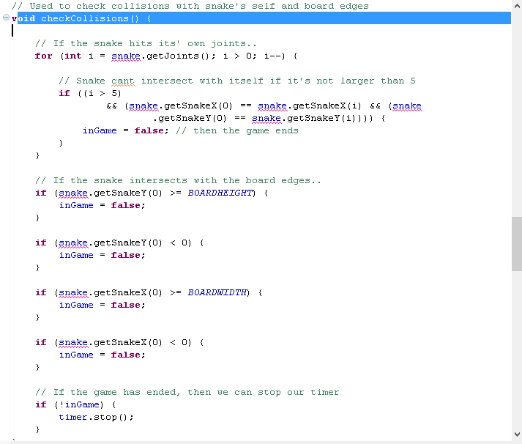
Board.java

Slide 11
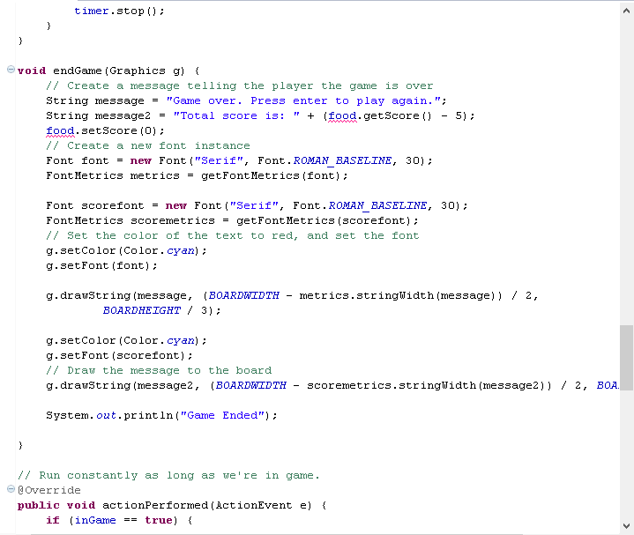
Board.java
cyan

Slide 12
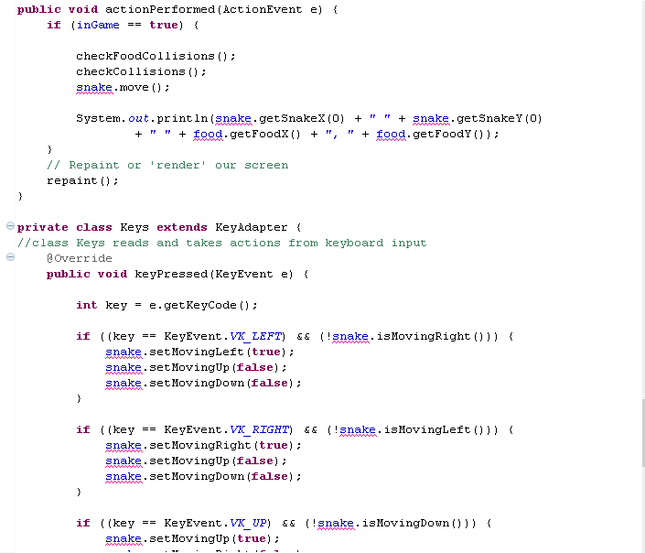
Board.java

Slide 13
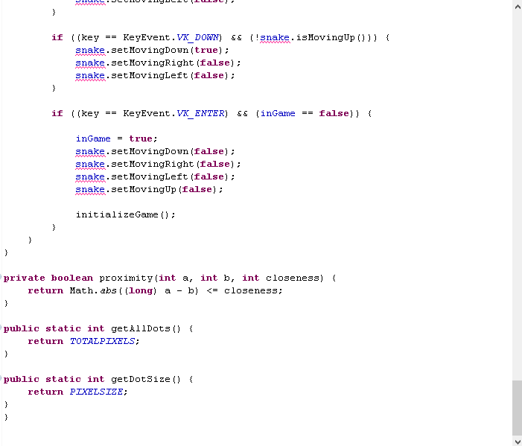
Board.java

Slide 14
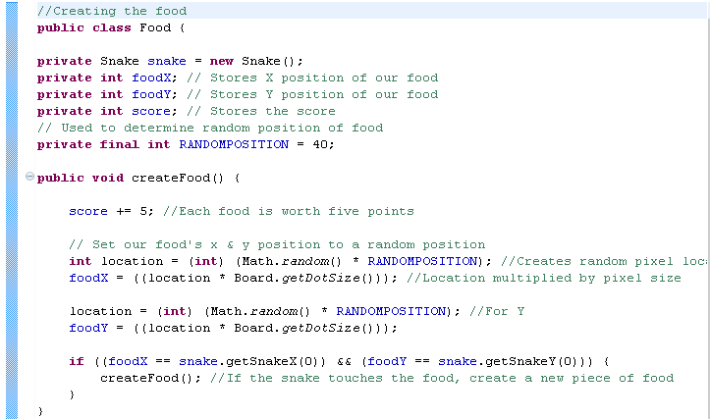
Food.java

Slide 15
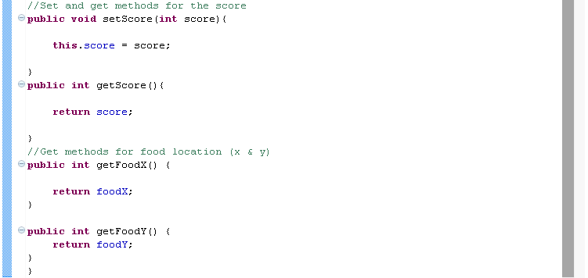
Food.java

Slide 16
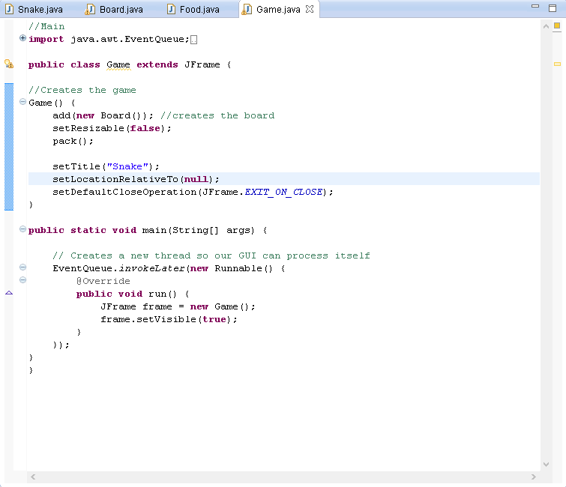
Game.java

Slide 17
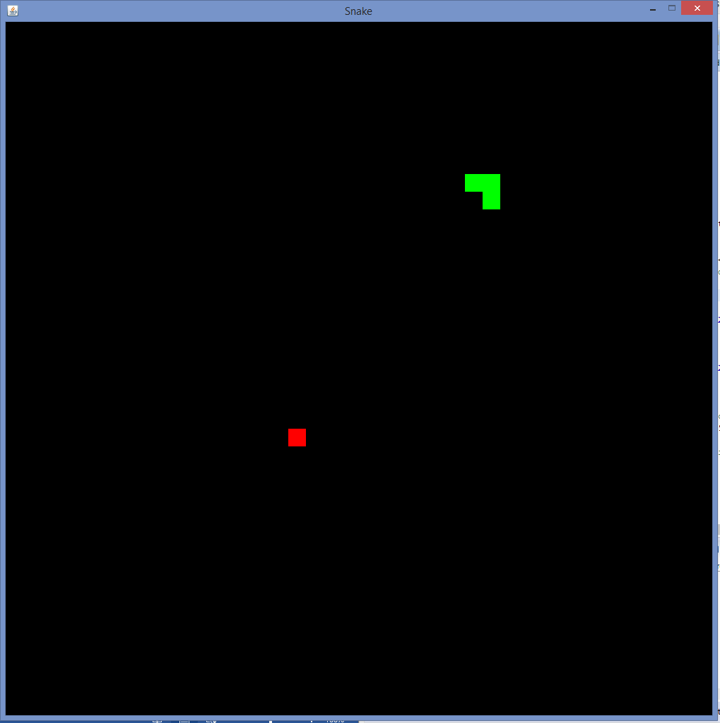

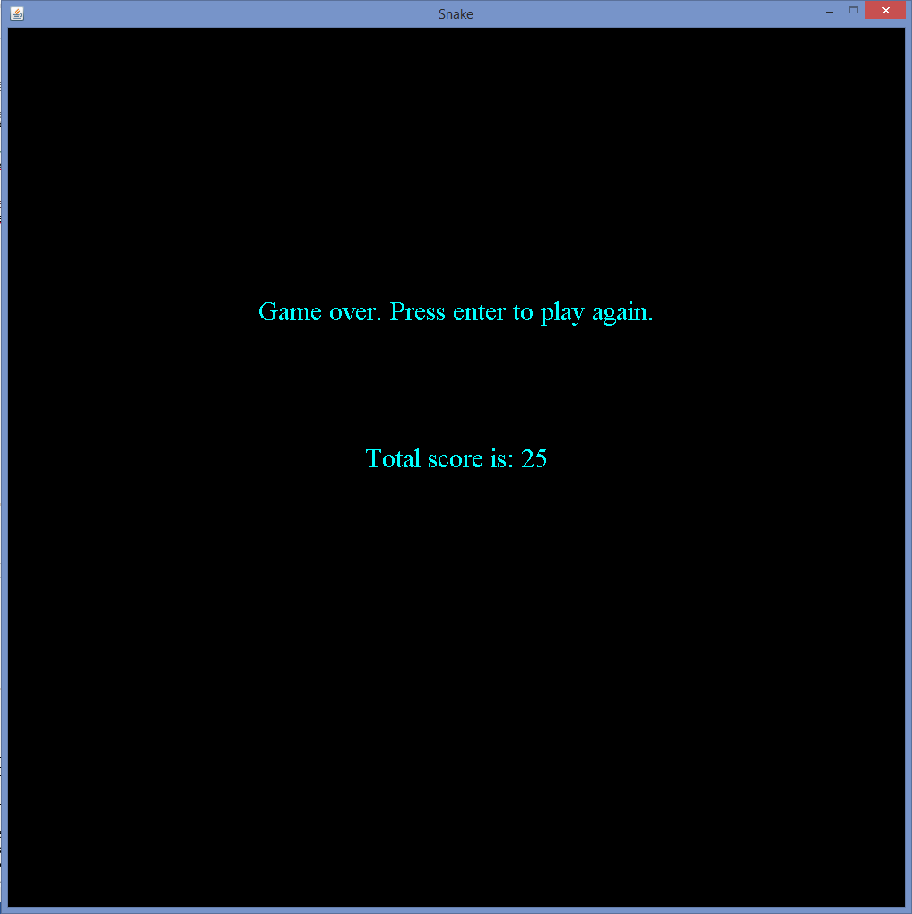

Screenshots

Slide 18
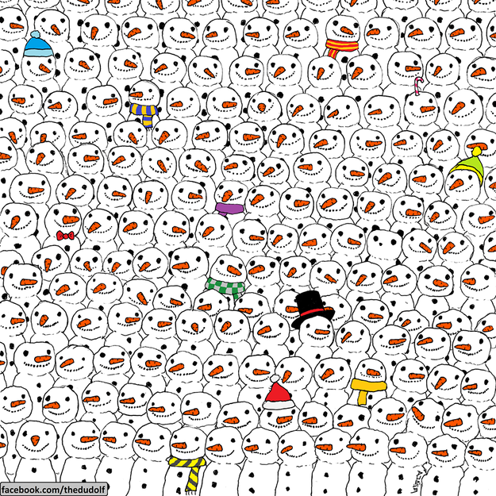
Demo Time!
While you’re waiting for the demo, find the panda →

Slide 19
Concepts
Learned During Class | New
All Code If/Else Statements For Statements Set and get methods Public/Private/Protected Methods Static/Void/Final Methods & Ints Public/Non-Public Classes @Override Snake.Java Arrays Board.Java GUI SecureRandom Switch Statements Graphics/Graphics2D Superclasses/Subclasses Timer | Snake.java Boolean Board.java setFocusable() setPreferredSize() Dimension() java.awt.Toolkit KeyAdapter KeyEvent KeyListener Game.java EventQueue Runnable() setLocationRelativeTo()

Slide 20
Thank you for listening!
If you want to demo the game or if you want to ask any questions, please talk to us at any time. We will be happy to walk you through the app.

